Slide 1
Finding the way towards Population Health Management on the Central Coast
24-11-2022

Slide 2
The Central Coast Research Institute acknowledges the traditional custodians of the land, the Darkinjung people, on whose land the Institute is situated and we welcome all who visit this place. We acknowledge the traditional custodians of lands on which we meet and conduct our research, and we pay our respects to their Elders past, present and emerging and to their culture, heritage and spirituality

Slide 3
Content
Population Health Management
Research process
Strenghts and weaknesses of the Central Coast
Limitations
Questions/discussion

Slide 4
Why this project?
Overburdened and costly care system
JSNA: Deep dive of the health and care needs on neighborhood level
Ambition: An intensive place-based population health improvement initiative
Aim for this project: Map the strenghts and weaknesses towards the implementation of PHM on the Central Coast

Slide 5
What do you think of when asked about Population Health Management on the Central Coast?
ⓘ Start presenting to display the poll results on this slide.

Slide 6
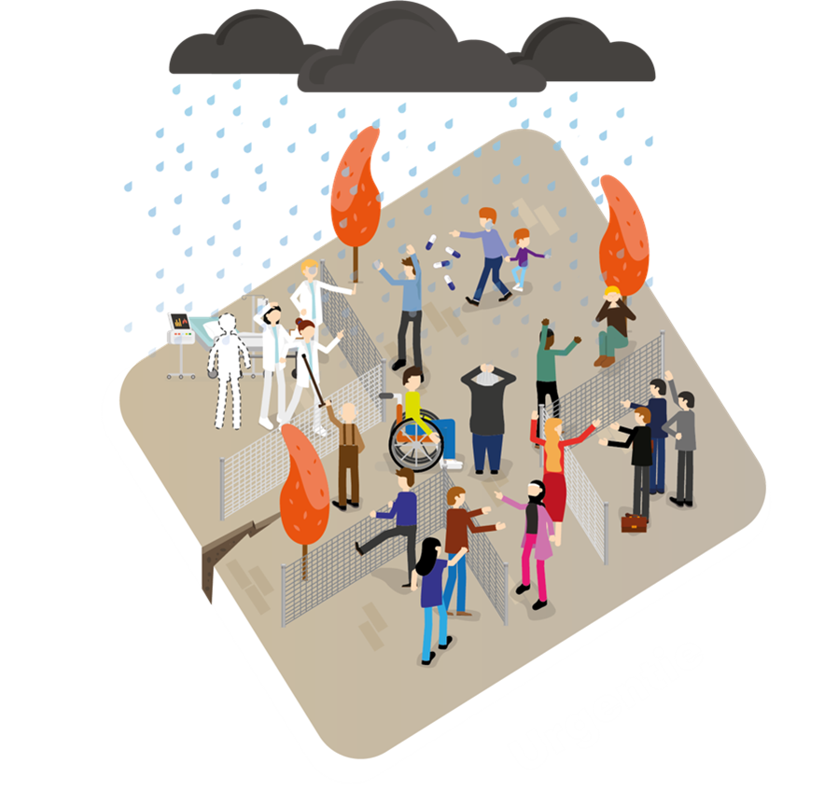
Population Health Management

Slide 7
Population Health Management Maturity Index
Accountable regional organization (20 items)
Cross domain business model (19 items)
Integrated data-infrastructure (19 items)
Co-designing workforce and community (14 items)
Population health data analytics (15 items)
Emergent implementation strategy (21 items)

Slide 8
Research process
Online PHM-MI
Workshop 1: Interpretation
Workshop 2: Results
Workshop 3: Implications

Slide 10
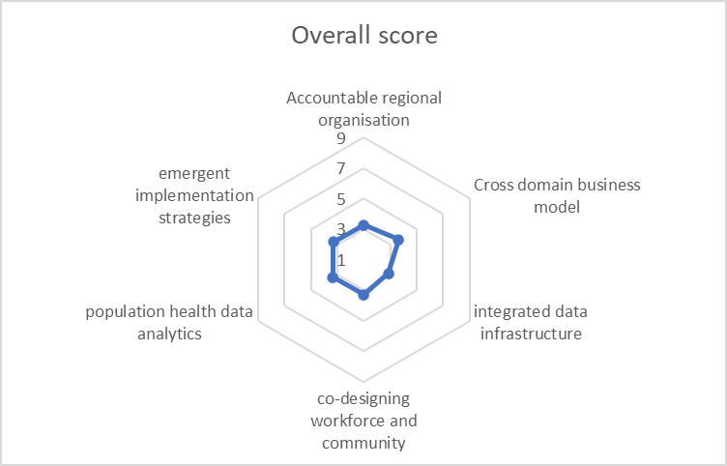
Results
69% (74/107) of the items scored 3 or lower
PHM-element ‘integrated data infrastructure’ 84% (16/19) of the items scored 3 or lower

Slide 11
Results ‘accountable regional organisation’
Network or alliance
Disaster response
Inward focus
Political influence
Median scores: 2-5
Average: 3.3

Slide 12
Results ‘cross domain business model’
Inequality of the system
Business community
Inward focus
Central Coast identity
Median scores: 2-6
Average: 3.6

Slide 13
Results ‘integrated data infrastructure’
Data availability
Laws and regulations
Inward focus
Shared vision on functionality
Median scores: 2-5
Average: 2.8

Slide 14
Results ‘co-designing workforce and community’
CE-level
Professionals
Managers
Community members
Median scores: 2-5
Average: 3.3

Slide 15
Results ‘population health data analytics’
Population segmentation
Risk stratification
Skilled professionals
Median scores: 2-5
Average: 3.3

Slide 16
Results ‘emergent implementation strategies’
Short-term focus
Skills and expertise
Median scores: 2-5
Average: 3.3
Learning environment
Regional ambition

Slide 17
Limitations
Interpretation of the items and the scores
Use of terminology
Number of particpants
Involved organizations

Slide 18
Conclusion
Notes:
Inter- and intra-organizational collaboration will be important to bring the hidden strengths on the Central Coast together and build a strong and enabling environment that can better support the health and wellbeing needs of the Central Coast community.

Slide 19
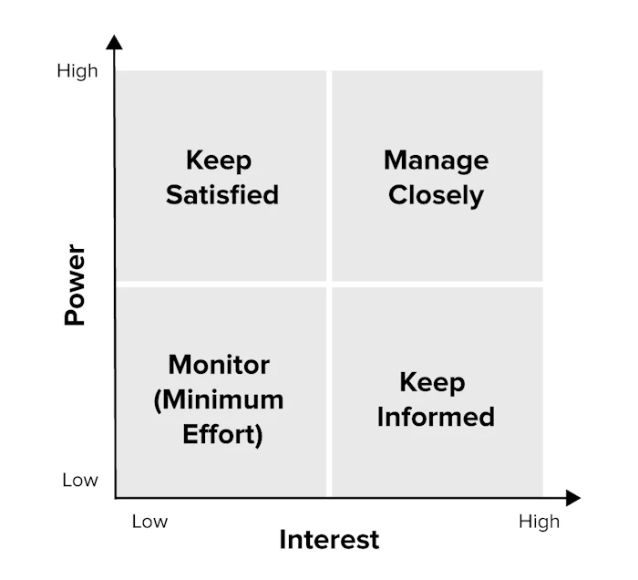
Stakeholder analysis of all health and wellbeing organisations
Examine:
Willingness for formal collaboration
Availability of data points
Financial streams and opportunities
Overlapping health services

Slide 20
Research team:
Annefrans van Ede, CCRI/LUMC (a.f.t.m.van_ede@lumc.nl)
Prof. Nick Goodwin, CCRI
Niki Kajons, CCLHD

Slide 21
Example of items
Accountable regional organization: ‘Multi-stakeholder governance structure across continuum of care’
Cross domain business model: ‘Financial incentives aligned with system goals’
Integrated data-infrastructure: ‘Investment up front and business plan to realize data infrastructure’
Co-designing workforce and community: ‘Co-creative interaction to come with the best model for change’
Population health data analytics: ‘Produce concise and useful datasets’
Emergent implementation: ‘Flexibility based on learning cycles’

Slide 22
Key strengths and weaknesses
Strengths of the Central Coast
Strategic momentum to focus on and address health needs across the Central Coast region.
A strong Central Coast identity, specifically amongst community members.
Willingness to collaborate and previous successes of collaboration in the COVID-19 epidemic and in disaster response around flooding and bush fires.
High availability of quantitative and qualitative data about the health and wellbeing and the needs of the Central Coast community.
Weaknesses of the Central Coast
A bureaucratic, fragmented, and competitive (health) system, making collaboration within and between organisations and professionals difficult and causing perceived dependence on political influences leading to a reluctance to act.
Available budgets and financial flows that are provided with different timings across different organizations in ways that are program-focussed, earmarked to specific deliverables, and highly controlled through clear reporting requirements on how resources are spent.
Involved organizations have an inward operational focus:
Strategies and priorities for action that meet organisational needs;
Available budgets and resources that are bounded to organisational objectives;
Quantitative and qualitative data about the health and wellbeing and the needs of Central Coast community members that are collated separately and not widely shared.
Many frameworks and plans have been created, but these do not appear to transition into implemented change. There is a disconnection between strategic planning and those who should benefit from these plans (community members).

Slide 23
Looking forward
There is a need to strengthen local alliances to provide focus and drive towards population health and to capitalise on current political momentum for change.
The principles of such alliances need to be based on building trust and connections, and to become action-oriented.
Long-term commitments across political cycles and shared resources that help to drive shared ambitions and aims are needed.
Making sustainable long-term change is likely to require a change of attitude across all involved stakeholders towards learning together and to work thorough how best to organize, finance, and monitor progress differently in ways that truly can put the community first.

